Slide 1


CITY TRAFFIC ACCIDENT RISK ANALYSIS
Domain : Traffic Management Department
Tools Used : Python, SQL, Power BI
Focus : High-risk traffic accident zones using historical and real-time data to improve road safety. It aims to help authorities take proactive measures and reduce accidents through data-driven insights.
Prepared by :
Badam Siva Rami Reddy

Slide 2
Contents
Business Problem
Project Overview and Scope
Project Architecture - Data Flow Diagram
Data Dictionary
Exploratory Data Analysis
Statistical and Business Insights(EDA)
Data Preprocessing
Data Visualization
Notes:
Change

Slide 3
Business Problem
--> The city is experiencing a high number of traffic accidents, especially at intersections and highways, due to factors such as unpredictable traffic flow, poorly timed signals, and varying road conditions.
--> Currently, there is no effective system in place to proactively identify accident-prone areas or provide early warnings, making it difficult for authorities to take preventive measures and reduce accident risks.

Slide 4
Project Overview and Scope
---> Client : One of the city traffic department in India.
The project focuses on analyzing historical traffic accident data to identify patterns and key risk factors influencing accidents.
It utilizes datasets including traffic flow, weather conditions, road types, and time-based variables such as peak hours and seasons.
Data preprocessing techniques like cleaning, transformation, and feature engineering are applied to ensure data quality and reliability.
The project incorporates data analytics and machine learning models to predict accident-prone areas such as intersections and highways.
Interactive dashboards and visualizations are developed to provide actionable insights for traffic authorities and decision-makers.
The scope is limited to analysis and prediction, aiming to improve road safety and reduce accidents, without involving real-time system deployment or automated traffic control.

Slide 5
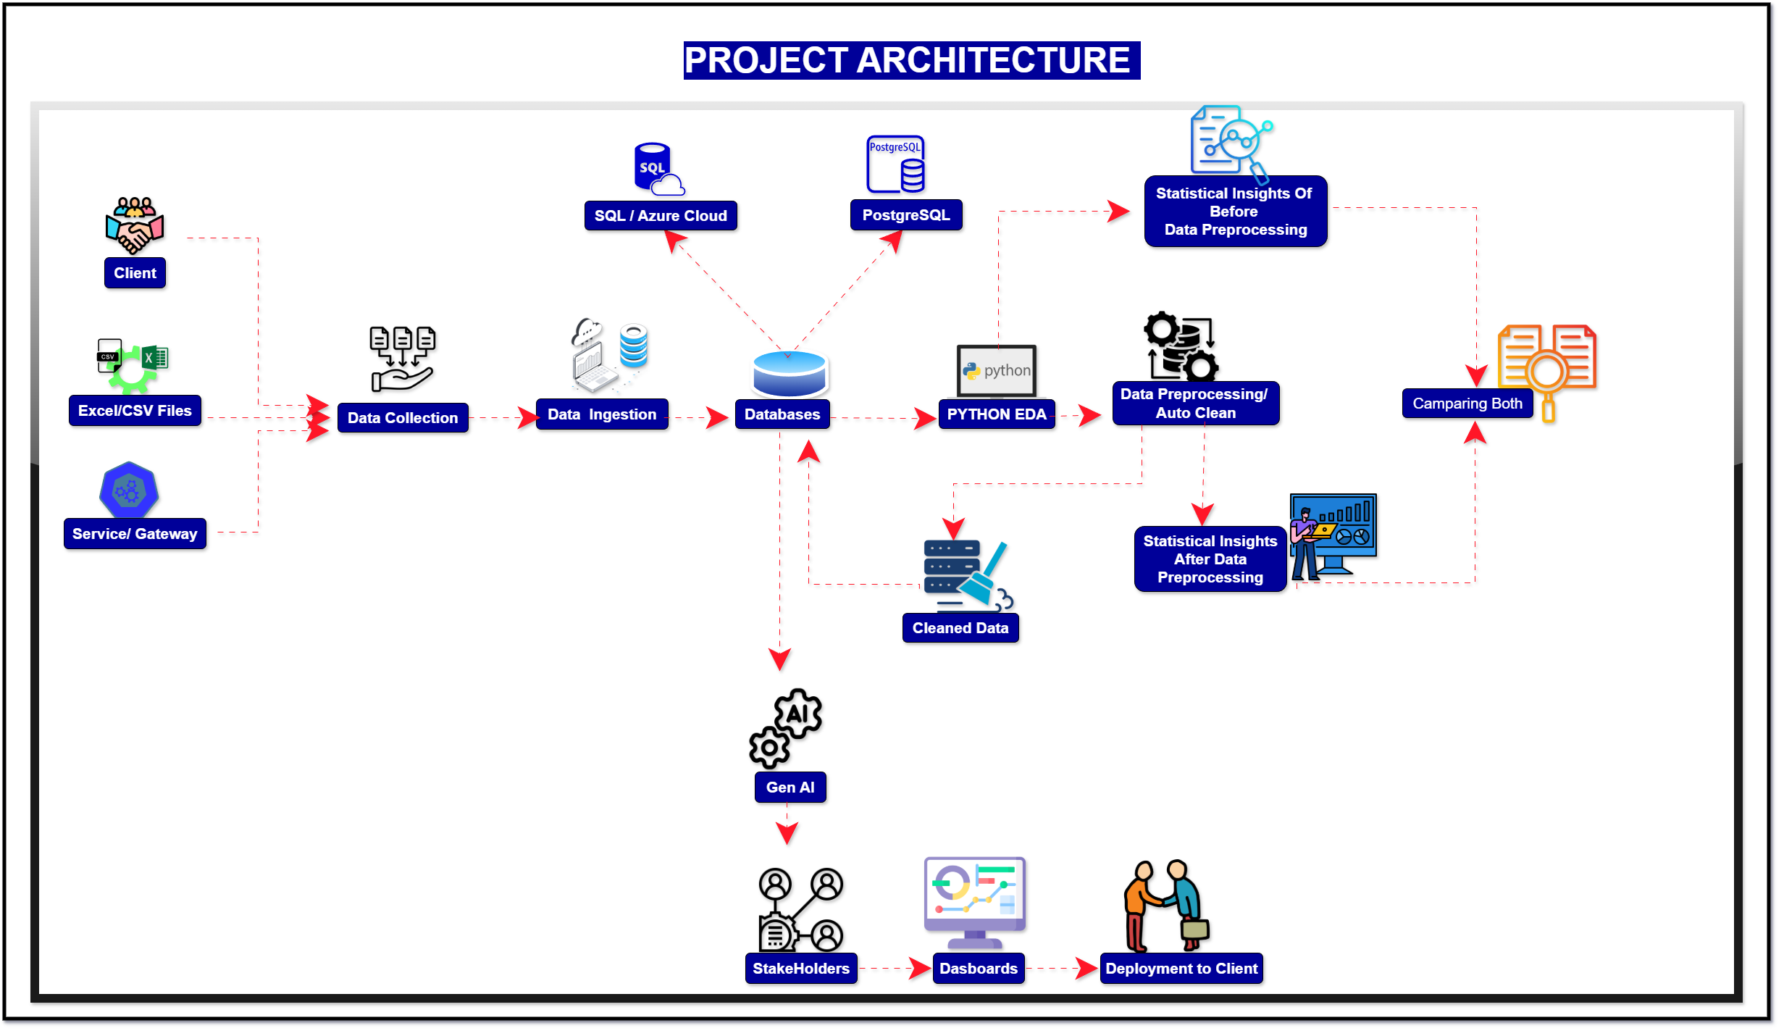
Project Architecture – Data Flow Diagram

Slide 6
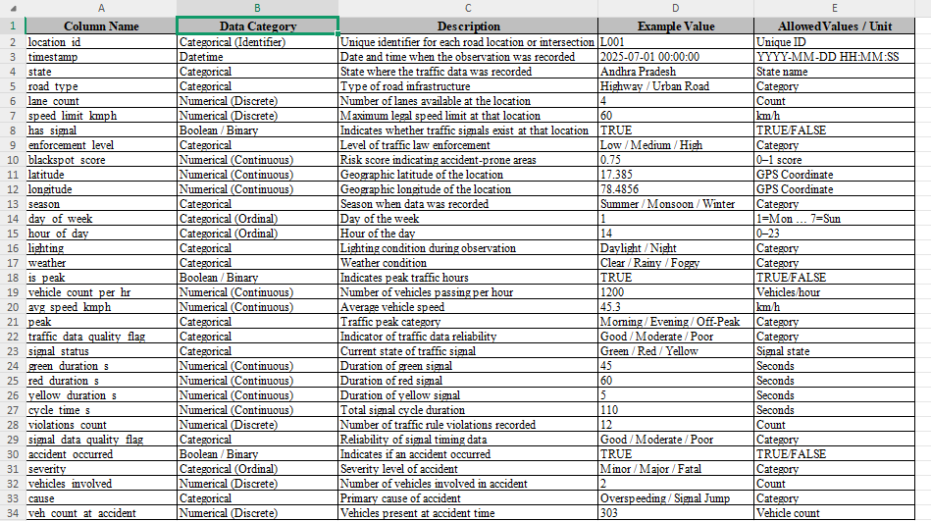
Data Dictionary

Slide 7
Exploratory Data Analysis(EDA)
Analyzed distribution and central tendency of accident frequency, severity, and traffic conditions.
Identified moderate accident occurrence across locations, indicating presence of high-risk zones.
Observed consistent accident patterns over time, highlighting recurring risk factors.
Accident data shows slight skewness toward peak hours, confirming time-based risk concentration.
Accident trends are stable with low variability, suggesting predictable traffic risk patterns.
Accident counts remain steady across weekdays, with comparatively lower incidents on weekends.
Overall trends suggest opportunities to reduce accident risk through better traffic planning and preventive measures without major infrastructure changes.

Slide 8
Exploratory Data Analysis [EDA]
Statistical Insights
Business Insights
• Average accident occurrence shows a slight concentration during specific peak hours, indicating time-based risk patterns.
• Accident distribution across locations reflects moderate clustering, highlighting certain high-risk zones.
• A significant proportion of accidents occurs under specific conditions such as poor lighting and adverse weather, indicating environmental.
• Accident patterns show consistent trends over time, suggesting stable but concerning risk.
• No major data gaps or anomalies are observed, ensuring reliability of the analysis.
• Daily accident counts are moderate with limited variation, indicating steady traffic risk levels.
• Accident frequency is relatively higher on weekdays compared to weekends due to increased traffic volume.
• High occurrence of accidents in specific zones indicates critical risk areas requiring immediate attention.
• Frequent accidents during peak hours highlight the need for better traffic management and signal optimization.
• Lack of recorded anomalies may indicate potential data limitations or underreporting of incidents.
• Consistent accident patterns suggest an opportunity to implement preventive measures without major infrastructure changes.
• Lower accident frequency during weekends indicates variation in traffic volume and risk levels.
• Authorities can reduce accident rates and improve road safety by using data-driven planning and targeted interventions.
Notes:
EDA is used for seeing what the data can tell us before the modeling task.
Change

Slide 9
Data Preprocessing
Reviewed the dataset structure and understood the business context of traffic accident data (location, time, weather, road conditions, etc.).
Corrected data types for date/time, numerical (speed, traffic volume), and categorical fields (weather, road type).
Handled missing values using statistical techniques and domain-based assumptions (e.g., weather or traffic conditions).
Removed duplicate and inconsistent accident records to ensure data accuracy.
Standardized categorical values such as location names, weather conditions, and road classifications.
Detected and treated outliers in variables like speed, accident severity, and traffic density.
Created derived features such as accident frequency, peak-hour indicators, and risk levels based on conditions.
Validated data consistency by checking logical constraints (e.g., speed limits, time ranges, accident severity levels).
Prepared the final cleaned dataset for Exploratory Data Analysis (EDA) and dashboard development using Power BI.
Notes:
Keep observations

Slide 10
Data Visualization
• Designed an interactive Power BI dashboard to monitor traffic accident patterns.
• Used KPI cards to display total accidents, high-risk zones, and accident severity levels.
• Created bar charts to compare accident frequency across road types, weather conditions, and locations.
• Used line charts to analyze daily, monthly, and seasonal accident trends.
• Implemented location-wise and condition-based filters for detailed drill-down analysis.
• Visualized the impact of factors like traffic volume, lighting, and weather on accident occurrence.
• Enabled quick identification of accident-prone areas and peak risk periods.
• Provided clear visual insights to support traffic management and safety decision-making.
Notes:
Add graphical

Slide 11
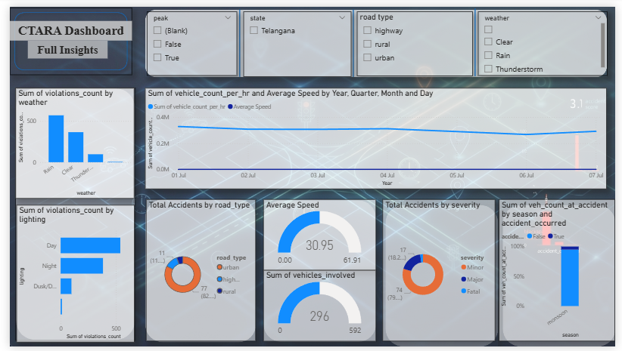
Data Visualization Using Power BI

Slide 12
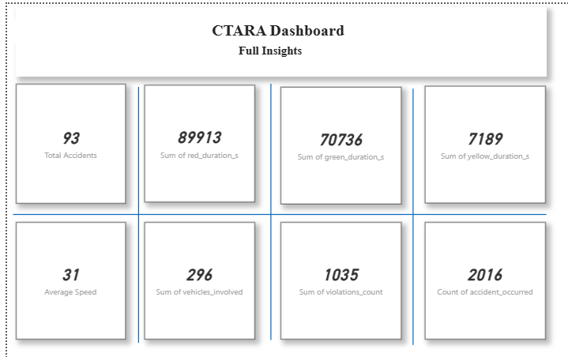
Data Visualization Using Power BI(KPI Cards)

Slide 13


